Slide 1
ASCA National Model
Notes:
Introduce self

Slide 2
Objectives
ASCA Model
Components (foundation, management, delivery and accountability)
Themes (leadership, collaboration, advocacy, systemic change)
Programs Should be Data Driven
Comprehensive School Counseling Program

Slide 3
Notes:
The model explained in detail in this book. Presentation based mostly on this book. The Purpose: 1. to help move school counseling from responsive services for some to a program for every student, 2. Provides uniformity to standardize counseling programs throughout the country, 3. To reestablish s counseling as a crucial ed function that is integral to aca achievement and student success.

Slide 4
Examples
It is a national model and each state are free to make some adaptations and changings according to their realities
Florida and Maine ☺

Slide 5
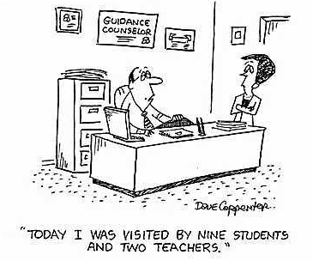

Slide 6
The American School Counselor Association 1
The American School Counselor Association (ASCA) has collaborated to create a National Model for School Counseling Programs to connect school counseling with current educational reform movements that emphasize student achievement and success
.

Slide 7
The American School Counselor Association 2
Operate from a formal set of Student Learning Objectives that are
Connected to National Standards
Based on measurable student learning outcomes
Are data-driven and accountable for student outcomes

Slide 8
Rationale
By aligning a counseling program with the school’s mission and school improvement plan, professional school counselors:
partner as leaders in systemic change
ensure equity and access
promote academic, career and personal/ social development for every student

Slide 9
ASCA National Model
Old question was what counselors do?
The School Counseling Program must answer this question:
“How are students different as a result of the school counseling program?”
ASCA National Model (Third Edition, 2012)

Slide 10
From Entitlement… to Performance
To a program that:
Focuses on outcomes and improved results
Measures impact related to goals
Attends to goals, objectives, and outcomes
Changes and adapts to be more responsive
From a program that:
Focuses generally on the number of activities
Measures the amount of effort
Attends to the process of doing work
Works to maintain the existing system
Notes:
This means moving from a culture of entitlement to a culture of performance, as mentioned earlier.
The National School Boards Association published an article that addressed the need for education to move from a entitlement culture to a performance culture.
We have taken this article and instead of reading through the administrators mind, or the school board members lens, or the teachers lens (which many have done) we have revised it to read through the school counselor and the school counseling programs’ lens.
For school counseling programs, this means moving from programs that focus on the number of activities we perform to focusing on the outcomes and results of these activities.
OK, so you held 10 guidance lessons this week, eight groups and saw 15 individual students…
SO WHAT??
Programs that focus on performance indicate the results of these activities.
Collecting process data is important so that programs can see what they are doing and for whom, but the outcomes of these programs are what stakeholders want to see; its what funding is based on.
Performance cultures focus on adapting and changing as the demographics change, as student needs change, instead of doing what we have always done.

Slide 11
From Entitlement… to Performance
From counselors who:
Focus on good intentions
Talk about how hard they work
Generally feel little need to change their behavior or approach
To counselors who:
Focus on accomplishments
Talk about effectiveness
Know their future rests on accomplishments
Communicate goals and objective
Notes:
We know that school counselors work very hard, and are very well intentioned, but intentions are not accomplishments.
I’d like to share an example. Recently, an ASCA Board member was interviewing a candidate for a school counseling position. One of the questions in the interview was “How will you know if your school counseling program is working? How will you measure results?” The candidates answer was (after a long pause) “Well, I guess, that if I feel good a the end of the day…..Then that’s results.”
Certainly we know there are times when we are faced with crisis on our worst day (students death) but that is also our best day because we “feel good” that we were able to assist in time of crisis. Our skill was necessary and utilized. Certainly, these are sad but professionally fulfilling moments.
But feeling “good” will not cut it with school boards. They want to know the “so what?” of your program, the effects.
Effort may not equal success and when it does not, do we do the same thing again? Or change and revise our programs to improve?
School counselors in a performance culture share effectiveness, communicate their goals to others and know that the future of the programs depends on their ability to accomplish their goal of improving academic success or students.

Slide 12
School Counseling Framework:
School counselor uses
counseling,
coordinating,
consulting,
curriculum developing and
delivery skills to implement the program.
The program that defines the activities and program evaluation methods is called a comprehensive school counseling program.
Notes:
It is important to share common language. What’s the difference? Page 5 of Framework.

Slide 13
Comprehensive school counseling program CSCP
School counselors design and deliver comprehensive school counseling programs that promote student achievement.
These programs are comprehensive in scope, preventative in design and developmental in nature.
School counseling programs should be an integral part of students’ daily educational environment, and
School counselors should be partners in student achievement

Slide 14
ASCA NATIONAL MODEL
Components :
1. Foundation
2. Management
3. Delivery
4. Accountability

Slide 15
Four Themes
Through the application of the four themes, counselors promote achievement and access to rigorous education that leads to closing achievement, opportunity and attainment gaps.
Leadership Collaboration
Advocacy
Systemic Change
Notes:
Read leadership quotes on pages 1. ~ advocacy places us at the forefront of school reform ~ Interprofessional, student, parent, family, Intra and Inter-organizational, community. Change may be needed to remove barriers, increase ed opp, promote skills for working w/ diverse pop., address over or under representation of specific groups in programs. S counseling programs that advocate for every student can prevent dropouts and maximize access to ed beyond HS. Ask people who caught themes to share ex. if they want

Slide 16
Collaboration
Bir elin nesi var iki elin sesi var!!!!
School counseling team
Support staff
Administrators
Teachers
Parents
Community (agencies)

Slide 17
Leadership
School counselors should take leadership responsibilities for change

Slide 18
Advocacy
Educational Equity ensures that each child is able to derive maximum benefit from his/her educational experience.

Slide 19
Systemic Change
Improve School Climate
Improve Attendance Attitudes
Academic Achievement

Slide 21
CSCP depends on data!
Information is power!!!
The most successful people get the best information!!!

Slide 22
Data Driven Programs
Needs Assessments (According to research findings, what students need?)
Set Goals (What we should do? How?)
Implement Interventions (Prepare or adapt programs and implement)
Evaluate (Effectiveness of what we did)

Slide 23
1. Foundation
Vision and mission statements defined to establish program focus
Student competencies developed around the three domains:
academic,
career and
personal/social development (Some adds 4th as community involvement)
Professional competencies outline the knowledge, skills and attitudes required, based on ASCA Ethical Standards for School Counselors
Need assessment
Notes:
Mention ASCA National Standards for Students Florida adds a 4th area “ community involvement/global citizenship.
Mention Ethical Standards can be found on page 85 of Framework, on the newer 2010 version can be downloaded. Can guide you when you are facing omplex legal and ethical challenges.

Slide 24
A Sample Vision Statement
The Comprehensive School Counseling Program will provide opportunities to assist all students as they develop the competencies needed for academic and personal development, positive mental health, and effective life skills, resulting in career and college readiness for each student.
Notes:
A vision statement defines what the future will look like in terms of student outcomes

Slide 25
A Sample Mission Statements
District: “Collaborating to meet the needs of each child”
Counseling program: “Collaborating to meet the unique needs of each student through a culturally sensitive developmental counseling model. By means of coordinating, counseling and consulting and through the use of data driven activities, students will be assisted in reaching their highest potential”
Notes:
The mission statement defines how the vision will be measured.

Slide 26
Student competencies
Identifies the specific attitudes, knowledge and skills that students should demonstrate as a result of program participation
Select Student Standards/Competencies/Indicators from “ASCA National Standards for Students”
Student Competency examples:
1. Develop the skills and attitudes for improving effectiveness as a learner.
2. Develop skills to locate, evaluate, and interpret career information.
3. Demonstrate positive interpersonal and communication skills.
Notes:
Or select competencies and indicators from NEFEC’s Comp School Counseling Plan. Samples = 1 academic, 1 career, 1 personal/social. Show how indicators relate to competencies (show Framework, p. 50). The competencies are the curriculum.

Slide 27
ASCA National Model School Counseling Program SMART Goals Worksheet
Specific Issue What is the specific issue based on our school’s data? | Grade 10 FCAT scores level 3 +: 2011 63% 2012 66% 2013 76%
Attainable What outcome would stretch us but is still attainable? | 2015 80%
Time Bound When will our goal be accomplished? | 2015
Measurable How will we measure the effectiveness of our interventions? | 2015 Florida Comprehensive Assessment, State Report of School Results
Results-Oriented Is the goal reported in results-oriented data (process, perception , outcome)? | ______________________________________________________________ Goal Statement: By the end of 2015 grade 10 L3+ FCAT scores = or >80%.
FCAT The Florida Comprehensive Assessment Test
Notes:
Program goals define how the vision and mission will be accomplished and guide the development of curriculum, action plans. Goal statement address specific outcomes. This sample template is provided when you purchase the ASCA book. Organizes/Focuses/systemizes goal setting. (show data file)

Slide 28
2. Management
School Counselor Competencies
Counseling Program Assessment
Use of time Assessment
Notes:
Developed and collected data from a student/faculty needs assessment a few years ago and developed and collected data from a faculty needs assessment in October.

Slide 29
Some Management Tools
Annual agreement (with administration)
Advisory council
Use of Data, Program results data
School Data Profile
Use of time-Suggested Percentages
Lesson Plans
Calendars - Planning/Participation
Notes:
Annual agreement includes: goals, use of time, services, planning and results documents, prof. dev., prof. collaboration, budget, hours/availability, role of support staff. Show school data profile. Pass around.

Slide 30
Annual agreement (with administration)
To ensure effective implementation of the program
Based on delivery systems and needs
Negotiated/changed every year

Slide 31
Advisory council
Group appointed to review the guidance program
Counselor, administrator, teachers, parents, students, community members

Slide 32
Examples of School Counselor Competencies
School counselors should possess the knowledge, abilities, skills and attitudes necessary to plan, organize, implement and evaluate a comprehensive, developmental, results-based school counseling program that aligns with the ASCA National Model.
I-A: Knowledge
ASCA’s position statement, The Professional School Counselor and School Counseling Preparation Programs, states that school counselors should articulate and demonstrate an understanding of:
__ I-A-1. The organizational structure and governance of the American educational system as well as cultural, political and social influences on current educational practices
__ I-A-2. The organizational structure and qualities of an effective school counseling program that aligns with the ASCA National Model
__ I-A-3. Impediments to student learning and use of advocacy and data-driven school counseling ­practices to act effectively in closing the achievement/opportunity gap
__ I-A-4. Leadership principles and theories
__ I-A-5. Individual counseling, group counseling and classroom guidance programs ensuring equitable access to resources that promote academic achievement; personal, social and emotional development; and career development including the identification of appropriate post-secondary education for every student
__ I-A-6. Collaborations with stakeholders such as parents and guardians, teachers, administrators and community leaders to create learning environments that promote educational equity and success for every student
__ I-A-7. Legal, ethical and professional issues in pre-K–12 schools
__ I-A-8. Developmental theory, learning theories, social justice theory, multiculturalism, counseling theories and career counseling theories
__ I-A-9. The continuum of mental health services, including prevention and intervention strategies to enhance student success
Notes:
(this 11 document P. 148 in the book)

Slide 33
Day Planner
Spiral Bound Notebook to log meetings, calls, etc.
Phone Log
Calendars
Disseminated to the faculty, staff, parents
These documents are not only to document your time , but also to make people aware of your contribution

Slide 34
A Sample Calendar
High School Counseling Department Calendar 2012-13 August
Register new students
Prepare for student’s return
Establish high school counseling calendar
Adjust student schedules
Write parent newsletter
In-service for any doctoral students and interns
New student orientation
Preplanning
Attend grade level team meetings, weekly *
Responsive Services, daily*
Student Services Meetings, Bi-weekly*
Last date for schedule changes Aug.31st
Assist with virtual school enrollment
Notes:
I will use this when I discuss annual plan with admin. Make it readily available.

Slide 35
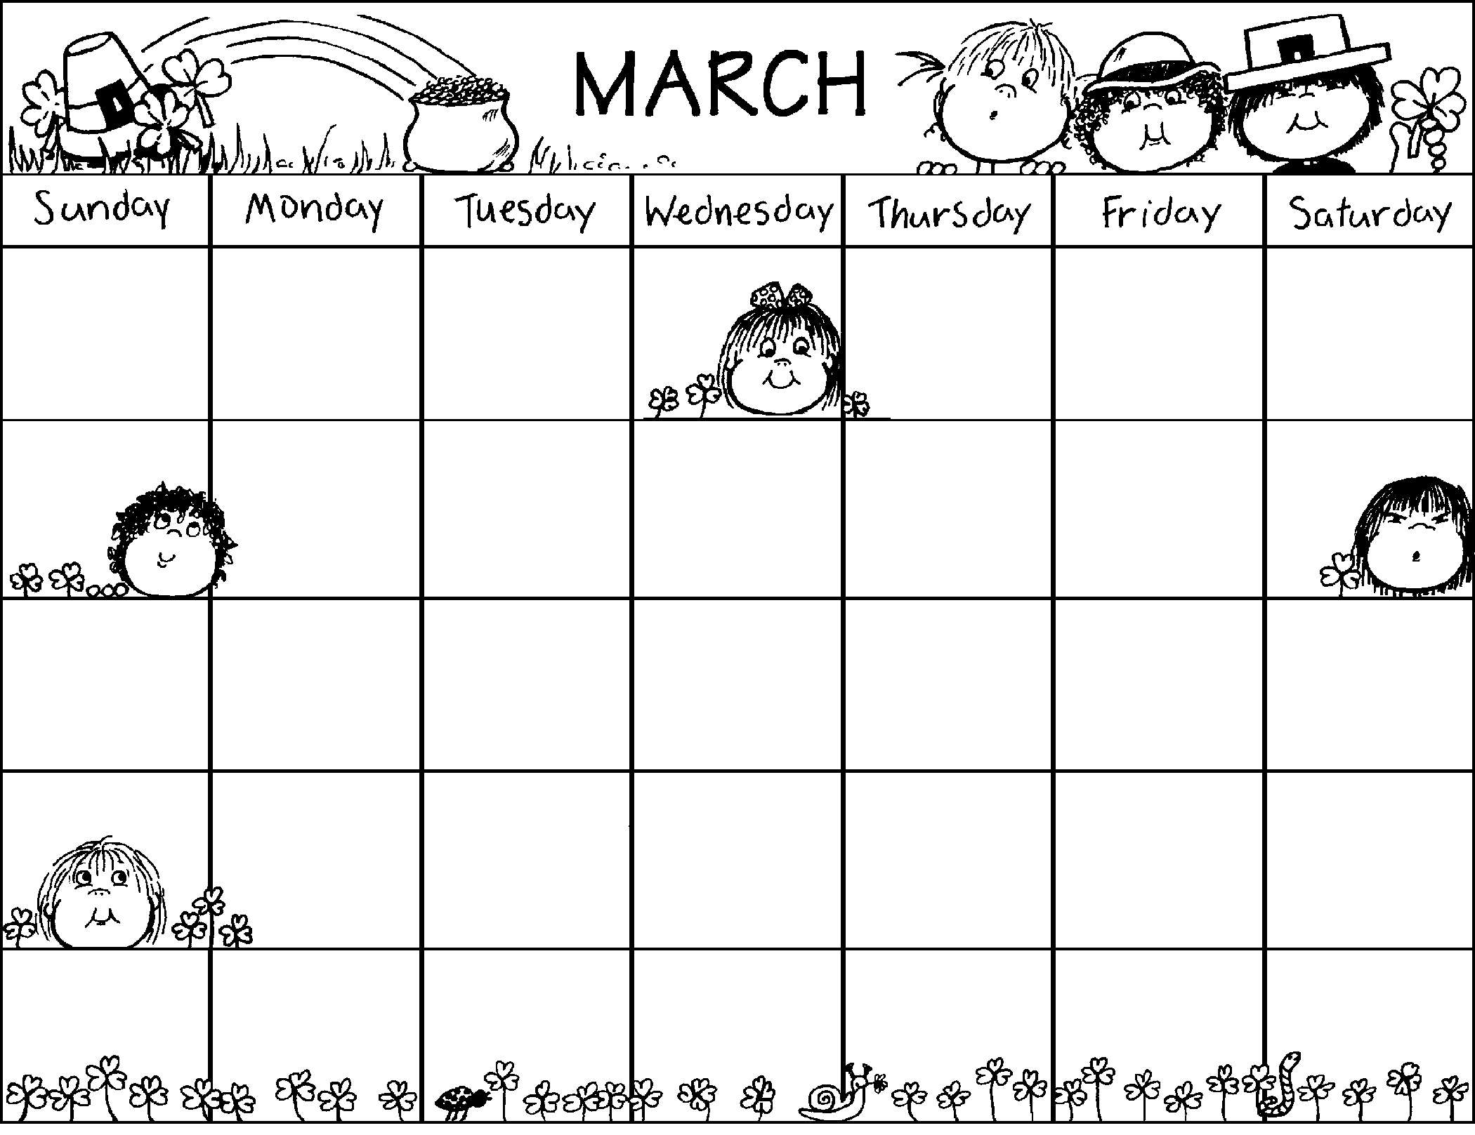
Calendar Example
1
2
3
11:40 – SBARC Mtg.
12:40 - SBARC Mtg.
9:00 – Meet w/ Hardship Trfr. Students
12:40 - SBARC Mtg.
3:00 – Mtg. w/parent re: student’s retention
Guidance Lesson – Test Taking Skills
4
5
6
7
8
8:00 – 29
11:00 BAC Training - Off Campus
12:40 - SBARC Mtg.
Shacklette visiting
Flexible
Professional Development Day – No School for Students
9:30 – A-Team Mtg.
11:30 - SBARC Mtg.
2:30 – Leadership Mtg.
9:30 - SBARC Mtg.
12:40 - SBARC Mtg.
2:30 – Tardy Detention
9
10
7:00 – Mtg. w/Teacher and Parent
9:30 – SBARC Mtg.
12:40 - SBARC Mtg.
11
12
13
14
15
16
17
9:30 - SBARC Mtg.
11:30 – ECE Placement Mtg.
2:40 – Leadership Mtg.
District M.S. Counseling Mtg. – Off Campus
2:30 – Faculty Mtg.
9:30 - SBARC Mtg.
12:40 - SBARC Mtg.
1:30 - SBARC Mtg.
9:30 - SBARC Mtg.
1:30 - SBARC Mtg.
2:30 – ECE Dept. Mtg.
Scheduling, Walk-Throughs, Parent Meetings, Student Counseling & Conferences, etc.
18
19
20
21
22
23
24
9:30 – A-Team Mtg.
8:40 - SBARC Mtg.
3:00 - SBARC Mtg. for Eisenhower 5th grader at Eisenhower
ILP Training at eMain – Off Campus
Scheduling, Walk-Throughs, Parent Meetings, Student Counseling & Conferences, etc.
11:30 - SBARC Mtg.
25
26
27
28
29
30
31
9:30 – A-Team Mtg. w/Dr. Ledford
3:30 Paint Ball Team
outing w/staff
Scheduling, Walk-Throughs, Parent Meetings, Student Counseling & Conferences, etc.
Guidance, Walk-Throughs
Guidance, Walk-Throughs
Guidance, Walk-Throughs

Slide 36
Action plans
Steven Covey said
Don’t prioritize your schedule but
schedule your priorities
School-Wide Campaigns
Classroom Lessons
Groups and Individuals
Based on Foundation, Data

Slide 37
Domain, standard and competency
Description of activity
Curriculum and materials to be used
Time Allotment
Person(s) responsible
Evaluation of student success
Expected result

Slide 38
Action Plan Reflections
Are your objectives measurable?
Can you use data elements that are already being collected?
Will the plan lead to results data?
How will you measure?
Pre/post tests
Comparison to baseline data

Slide 39
Distribution of Time
 | Elementary | Middle school | High School
Guidance Curriculum | 35 – 45% | 25 – 35% | 15 -25%
Individual Planning | 5 – 10% | 15 – 25% | 25 – 35%
Responsive Services | 30 – 40% | 30 – 40% | 25 – 35%
System Support | 15 -25% | 10 -15% | 15 – 20%

Slide 40
Use of time Assessment
Use of Time Analysis; at least 80% of a counselors time should be spent on direct and indirect student services.
Less that 20% on management and fair share responsibilities.

Slide 41
3. Delivery Direct Student Services
School Counseling Core Curriculum;
Individual Student Planning
Responsive Services
System support

Slide 42
School Counseling Core Curriculum
Comprehensive, written instructional program, preventative, developmental
Structured lessons delivered to all students
Related to standards and competencies
Integrated with academic curriculum
Use data to develop lessons
Environmental issues
Discipline records
Student records
Standardized test scores

Slide 43
Individual Student Planning
Appraisal, advisement to establish goals and plans
Ongoing systemic activities
Designed to assist students in establishing personal goals
Designed to assist students in developing future plans
Helps students get from point A to point B

Slide 44
During this process….
Counselor Planned and Directed
Test score review, interpretation and analysis
Promotion and retention information
Career decision making
Yearly course selection
Test taking strategies

Slide 45
Responsive Services
Meeting students immediate needs, crisis intervention, referral and follow-up
Designed to meet students’ immediate needs
Individual, group and crisis counseling
Consultation, referral, mediation and information
Available to all students and parents

Slide 46
System support
Activities targeted at maintaining and enhancing the educational environment and school climate.
Program management activities that establish, maintain, and enhance the program
Professional development activities
Consultation, collaboration and teaming

Slide 47
Indirect Student Services
Referrals; directs students and families to school and community resources
Consultation; share strategies with parents, other educators and organizations to promote academic, career and personal development
Collaboration; teaming, committee work, workshops
Notes:
RTI, MTSS

Slide 48
4. Accountability
Now , more than ever school counselor are expected to demonstrate the effectiveness of their programs in measurable terms.

Slide 49
How are students different because of the School Counseling Program?
School counseling programs are about results.
How are students different as a result of the school counseling program?

Slide 50
Results Report
School Counselor Performance Evaluation
The Program Audit
Academic, Behavior and Attendance Data

Slide 51
Data Analysis
School Data Profile Analysis; strengths, concerns, achievement gaps, attendance issues?
Notes:
Saw data profile analysis when I discusses Management tools. Show the Data File I assembled

Slide 52
Without data you can only hope that your program is effective
Having a data driven school counseling program means that at each state of program delivery and assessment, data is used to inform decisions.
Data identifies the population in need of intervention.
Data drives decisions about goals of the intervention….
Systemic change does not occur with out collecting and examining data to understand the cause of the issue or the gap.

Slide 53
Three Types of Data
Process, ex: # of participants, # of times intervention took place, evidence that the event occurred
Perception, ex: Asks what participants know or can do, collected through surveys, that measure attainment of competencies, attitudes, beliefs and perceived gains in knowledge
Outcome, ex: reports the extent to which the program had a positive impact on students’ ability to use their knowledge, attitudes and skills to improve achievement, attendance, behavior. Collected from multiple sources

Slide 54
Sample results report Post high school planning
Target Group: Senior Students
Standard: Students will acquire the academic preparation necessary to choose from a wide variety of educational, training, and employment options upon completion of secondary school
Sessions/activities: 2 individual conferences, 2 classroom lessons, 2 evening programs, 2 senior newsletters
Notes:
Share your result reports! Websites, handouts, reports to admin and school board, presentation to faculty, add to district data materials (annual report)

Slide 55
Process data: 116 seniors (class of 2013)
Perception Data: A needs assessment was given to 260 PKY HS students. 90% of the students reported that the following competencies must be priorities in the counseling program:
1. Getting info about education options after HS
2. Getting financial info to prepare for college
3. Help applying to college
Outcome data: 44% of class accepted at and indicated they would attend 4 year college/university, 49% accepted at and indicated they would attend 2 year college or state college.
Notes:
Share your result reports! Websites, handouts, reports to admin and school board, presentation to faculty, add to district data materials (annual report)

Slide 56
Academic Improvement ******* High School
Year 1 - 12 9th grade - 18% increase
Year 2 - 250 9th - 1.5 to 2.5 GPA
Year 3 - 500 9th - 2% att. Increase
Year 4 - 500 9th - 21% fewer “F”s

Slide 57
**** Student Survey
Year 1 Year 2
Alcohol/drug use a problem 44 26
Do you like going to school? 65 81
Do most students follow rules? 36 73
Are all races treated the same? 68 84
Is the school clean and neat? 62 82

Slide 58
School Counseling Outcomes
School Counseling
Program
Career
Development
Outcomes
Systemic
Interventions
Academic
Development
Outcomes
Individual
Interventions
Personal/Social
Development
Outcomes

Slide 59
Implications of ASCA Model
What is the purpose of the school counseling program?
What are the desired outcomes or results?
What is being done to achieve results?
What evidence is there that the objectives have been met?
Is the program making a difference?
Notes:
READ SLIDE

Slide 60
Activities for School Counselors
Appropriate
Inappropriate
Individual student academic planning
Interpreting cognitive, aptitude and achievement tests
Providing counseling to students who are tardy or absent
Providing counseling to students who have disciplinary problems
Providing counseling to students as to appropriate school dress
Collaborating with teachers to present school counseling core curriculum lessons
Analyzing grade point averages in relationship to achievement
Coordinating paperwork and data entry for new students
Coordinating cognitive aptitude and achievement testing program
Signing excuses for students who are tardy or absent
Performing disciplinary actions
Sending students home who are not appropriately dressed
Teaching classes when teachers are absent
Computing grade point averages

Slide 61
Contunies…
Appropriate
Inappropriate
Interpreting students records
Providing teachers with suggestions for effective classroom management
Ensuring student records are maintained per state and federal regulations
Helping the principal identify and resolve student issues, needs and problems
Providing individual and small group counseling
Advocating for students at IEP meetings, and student study teams
Analyzing disaggregated data
Maintaining students records
Supervising classrooms or common areas
Keeping clerical records
Assisting with duties in the principal’s office
Providing therapy or long-term counseling to address psychology disorders
Coordinating IEP’s or student study teams
Serving as a data entry clerk

Slide 62
MONE Regulation
Verilemeyecek Görevler
Madde 55 -Eğitim-öğretim kurumlarındaki rehberlik ve psikolojik danışma servislerinde görevli psikolojik danışmanlara yönetim, büro işlerinde, ders, nöbet ve sınav gibi rehberlik ve psikolojik danışmadaki hizmet alanlarıyla ilişkisiz konularda görev verilemez. Ancak bu durum yönetici olarak atanmalarına engel teşkil etmez.

Slide 63
IMPLEMENTATION !!!
Administrator Support
Planned Steps
On-going Program Evaluation

Slide 64
Steps to Implementation
What if my school doesn’t want to change?
Ask yourself…
What are my students’ needs?
What do I want to change?
What do I have the power to change?
What am I already doing that can be measured?
Start small and use that data to support further expansion and change

Slide 65
1. Planning the Program
2. Building Your Foundation
3. Designing the Delivery System
4. Implementing the Program
. Making the Program Accountable

Slide 66
Next Steps
Review action plans
Learn from experience
Look at ways to implement new pieces of the National Model each year for 3 -5 years

Slide 67
Start with what you can manage
Align with school and national goals
Collect data!
Write measurable goals and objectives that are reasonable
Write plans early, review them regularly

Slide 68
Best Practices
Understand the trends, work with the details
Collaborate with others at your school
Collaborate with other schools

